Slide 1
CSET335L (Deep Learning)
Lecture 9: Overfitting, Regularization
Deepika Vatsa

Slide 2
Outline
Model improvement
Overfitting
Underfitting
Regularization
  L1 and L2 regularization
  Drop out
  Early stopping

Slide 3
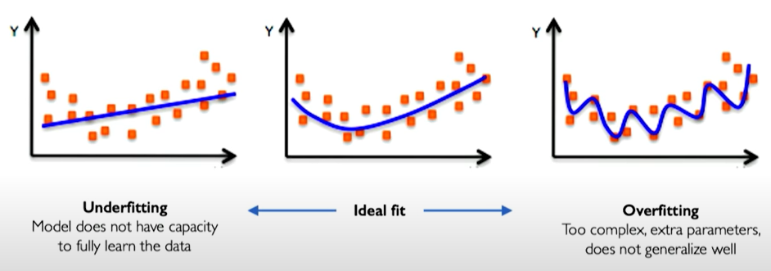

Model improvement
Objective of model fitting: We want models to learn a representation of our data that can generalize to new data.
Problems in machine learning and deep learning
Notes:
In machine learning, given a set of data points, we want to fit the model to approximate the data set
We want models to learn a representation of our data that can generalize to new data.
As we can see, the left curve cannot generalize well to the data points since it is not capturing all the intricacies of data points.
While the right curve is fitting too well, like going through every point of training data. Though it is covering all the intricacies of data this one is not going to generalize to a new data point.
So we want an ideal fit (middle one) where we cover the overall trend of data and can generalize well to the test data.

Slide 4
Problem of Overfitting
Defined as the inability of the model to generalize.
Analogy: This is the same as memorizing the answers to a Maths quiz instead of knowing the formulas. Because of this, the model cannot generalize. Everything is all good as long as you are in familiar territory, but as soon as you step outside, you’re lost.

Slide 5

Problem of Overfitting

Slide 6
Ways to mitigate overfitting
Gather more data:
  As we add more data, the model becomes unable to overfit all the samples, and is forced to generalize to make progress.
Regularization: Reduce model complexity by constraining the optimization problem
Data augmentation & Noise:
  Data collection is a tedious and expensive process. If it is not possible, we should try to make your data appear as if it was more diverse. For that, data augmentation techniques can be used.
Notes:
Collecting more examples should be the first step in every data science task, as more data will result in an increased accuracy of the model, while reducing the chance of overfitting
To do that, use data augmentation techniques so that each time a sample is processed by the model, it’s slightly different from the previous time. This will make it harder for the model to learn parameters for each sample.

Slide 7

Regularization
One of the techniques used to overcome the problem of overfitting
Introduced in training to constrain our optimization problem to discourage complex models
Improve generalization of our model on unseen data
In regularization, we want to allow some error on training data.

Slide 8
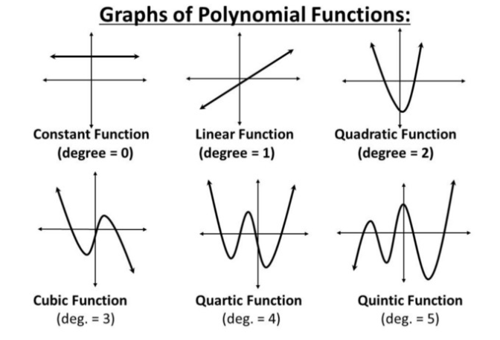
Regularization

Slide 9
















Regularization

Slide 10
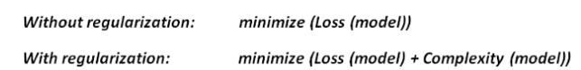

Regularization
Regularization controls the model complexity by penalizing higher terms in the model. If a regularization term is added, the model tries to minimize both loss and complexity of model.
Notes:
To think simply about L2 regularization from the viewpoint of optimizing the cost function, as we add the regularization term to the cost function we are actually increasing the value of the cost function. Hence, if the weights will be larger it will also make the cost to go up and the training algorithm will try to bring the weights down by penalizing the weights forcing them to take smaller values thereby regularizing the network.

Slide 11
Regularization techniques
L1 Regularization (Lasso)
L2 regularization (Ridge)
Early Stopping
Drop out

Slide 12














L1 Regularization
Add a penalty to the loss function.
L1 regularization: Penalizes absolute weights. Makes few weights which are near zero to be zero and allow few weights to remain high.

Slide 13





L2 Regularization
Add a penalty to the loss function
L2 regularization (Ridge Regularization): Penalizes squared weights. Make weights small.
Notes:
L2 regularization is often referred to as weight decay since it makes the weights smaller. Hence you can see why regularization works, it makes the weights of the network smaller. The smallness of weights implies that the network behaviour won’t change much if we change a few random inputs here and there which in turn makes it difficult for the regularized network to learn local noise in the data. This forces the network to learn only those features which are seen often across the training set.

Slide 14
Regularization parameter λ
If λ = 0 , regularized loss will become original loss
If λ = ∞ , weights will become zero. Because only at zero weights, the loss will be minimum, else it will be infinity.
If 0 < λ < ∞ : Positive λ will cause the magnitude of the weights to be smaller than in the usual linear solution. As we increase the λ, weights will shrink more

Slide 15
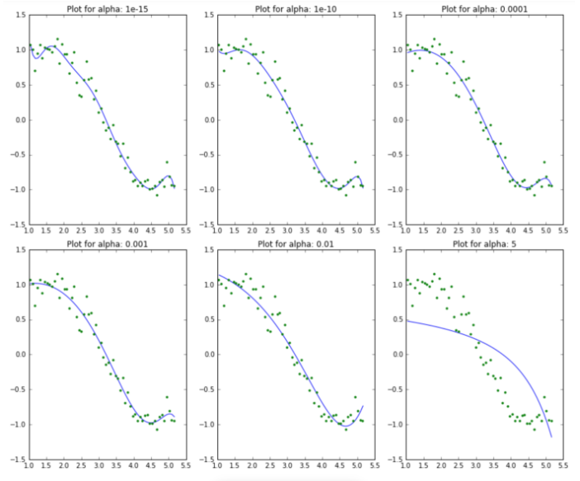
Regularization
As the value of λ increases, the model complexity reduces.
Higher the λ, bigger the penalty.
Though higher values of λ reduce overfitting, significantly high values can cause underfitting as well (eg. λ= 5)

Slide 16

L1 and L2 Regularization
The L1 penalty enforces feature selection
  Has a tendency to set to 0 the less useful parameters.
  This helps identify the most relevant features in a dataset.
  Often not as computationally efficient as the L2 penalty.
L1 matrix is sparse with many zeros, and the L2 matrix has slightly smaller weights.
L2 penalty enforces weights shrinkage.

Slide 17
L1 and L2 Regularization
L1 penalty enforces feature selection
L2 penalty enforces weight shrinkage
Weight constraints in Keras : https://keras.io/api/layers/constraints/#layer-weight-constraints

Slide 18
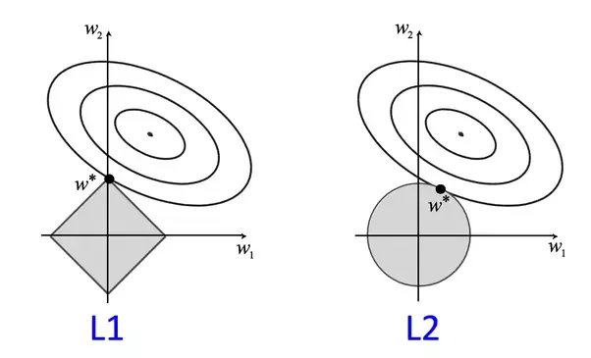















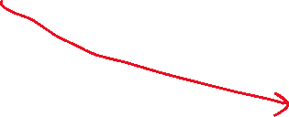



Visualizing L2 Regularization
Notes:
I want to quantify the penalty a. That sum of sq of weights should be less than a. This bound a is specified in keras as maxnorm constraint.
Y hat is function of weights: w1 and w2.
Since loss term is also square, it is shown as circle.
When we minimize this loss term completely, it will be at the center point.
But we donot want 0 loss/error on training data. (implies overfitting)
So we need to relax this error. Depending upon the amount of error we relax, we get all these outer circles.
We only want to allow on that much error, such that our model predicts well on the test data. That’s when the regularization term comes in.
We want the intersection of maximum error we can allow on training data and regularization term (which specifies the bound on weights).

Slide 19












Visualizing L1 Regularization
Notes:
For intersection on axis, it is not required for the center of loss (where loss = 0) to be on axis.
While in L2

Slide 20

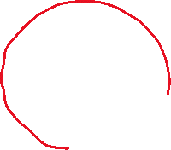


Visualizing L1 and L2 Regularization
Notes:
In L1, for intersection on axis, it is not required for the center of loss (where loss = 0) to be on axis. And therefore, some features can be zero in L1 regularization.
Though it is not mandatory that it makes some features zero. Here we are visualizing just two weights means two input features x1 and x2. But in reality we have so many features, and L1 regularization makes some of them to be zero in case where there are correlated features or useless features.
While in L2, for intersection on axis means that the loss center is also on axis. Black circle should be on top of grey circle. And is loss center is on axis then that means in the original loss also, one of the weights is 0. So, regularizer is not involved in making w1 to be 0. That’s why none of the features is set to 0 in L2 regularization. Thus L2 regularization shrinks the weight values. (Visually compare w1 and w2 values at point loss = 0 and at w*)

Slide 21
References
MIT Introduction to Deep Learning | 6.S191 by Alexander Amini
https://www.youtube.com/watch?v=7sB052Pz0sQ&list=PLtBw6njQRU-rwp5__7C0oIVt26ZgjG9NI
L1 and L2 Regularization
https://www.youtube.com/watch?v=QNxNCgtWSaY

